Slide 1





THERMAL POWER IN
NUCLEAR
PROPULSION
Embry-Riddle Aeronautical University College of Arts and Sciences, Department of Physics and Astronomy
Investigating centrifugal nuclear thermal rocket propulsion
PRESENTED BY
Shannon Moore
Hayden West
Mentor: Dr. Darrel Smith

Slide 2

Chemical vs NTP vs CNTP Propulsion
Chemical/ Traditional Propulsion
Heating agent = propellant
Nuclear Thermal Propulsion (NTP)
Heating agent = Solid core rocket with U-235 and U-238
Propellant = Hydrogen, for example
Temperature ~ 1500K
Centrifugal Nuclear Thermal Propulsion (CNTP)
Heating agent = Liquid core rocket with U-235 and U-238 (19% / 81%)
Propellant = Hydrogen, Ammonia, for example
Temperature ~5000K

Slide 3
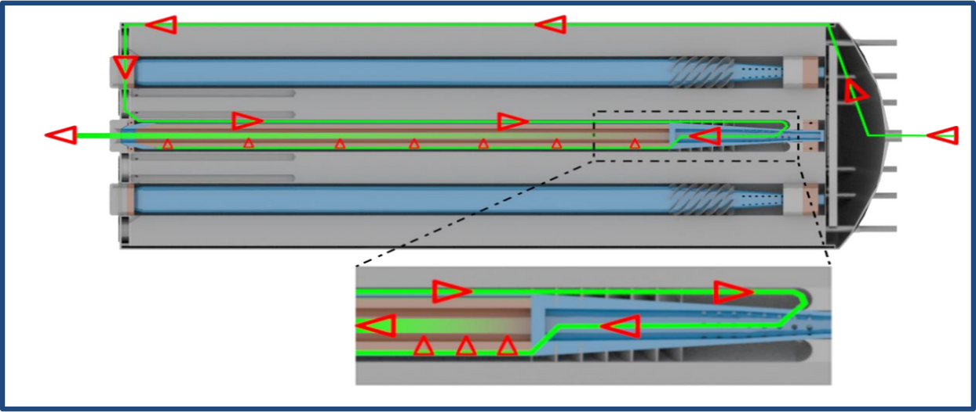


Design and Configuration of a CNTP Rocket
Fisher, Ethan, et al. “Centrifuge Layout and Propellant Flow Path.” CNTR: Explanation of Propellant Flow and Description of Initial Experiments, University of Alabama Huntsville, Mar. 2021. Accessed Apr. 2023.

Slide 4
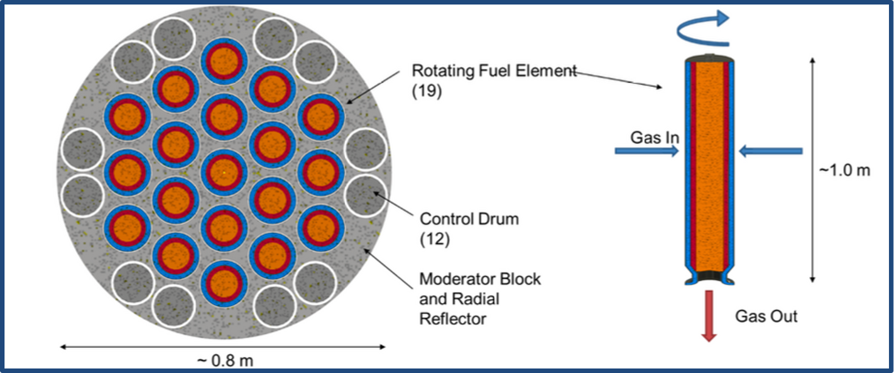
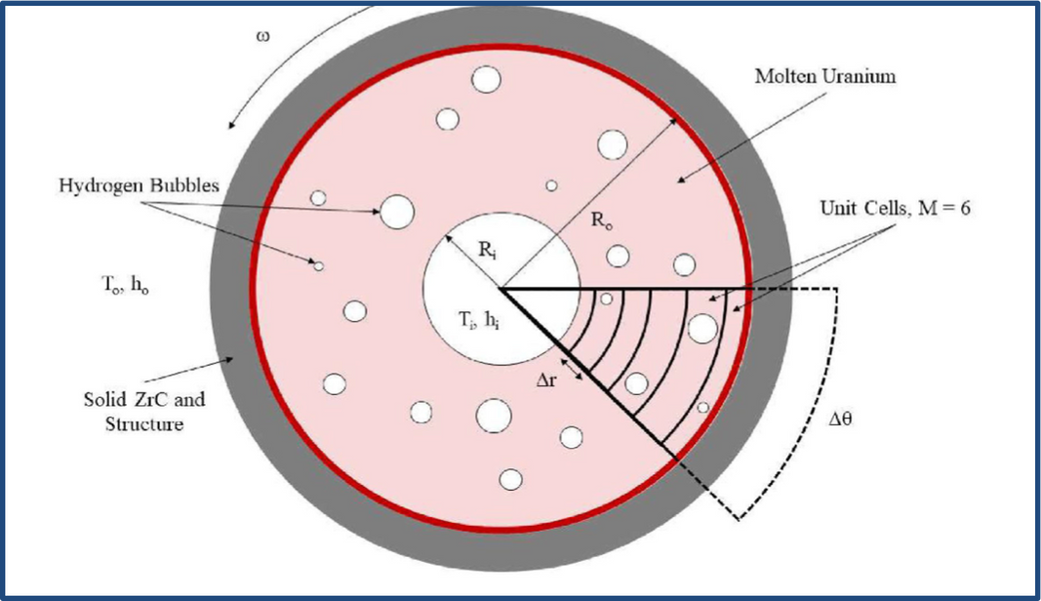
Modeling a Single Cell
Bubbles
Heat
Mass Flow
Jarrett , Michael, et al. “Thermohydraulic Analysis and Startup Conditions of a Centrifugal Nuclear Thermal Rocket.” 2021, Accessed 6 Feb. 2023.

Slide 5
Nitrogen and Hydrogen Constituents
Hydrogen:
Light with very little mass
Difficult to control
Ammonia:
Nitrogen and Hydrogen make up
Similar properties to Hydrogen
Easier to manipulate

Slide 6
Project Goals
Implement heat profile into Python/Matlab
Model heat transfer between fuel elements (cells)
Evaluate the total one dimensional heat distribution
Replace Hydrogen with Ammonia
Optimize the performance of the CNTP engine by iterating through physical parameters multiple times

Slide 7
Special Thanks To:
Embry-Riddle Aeronautical University, Undergraduate Research Institution and Space Grant committee
Faculty Mentor: Dr. Darrel Smith
Tristan Muzzy and the Senior Capstone Research Team

